Slide 1
Welcome to Section
Week 3 - Fly me to the Mars
Slides created by
Cameron Mohne and Maggie Lee
Notes:
Hey all, welcome back to section! It is week 3 and today, we’ll be taking our minds and code to outer space!

Slide 2
Agenda
01
02
Check-in
Recap
03
04
To Mars!!!
To Infinity & Beyond
How are all of you doing?
Revisiting lecture content
Section Problem #1
Section Problem #2
Notes:
On today’s agenda, we of course have a lovely check-in to see how you all are doing; this week, we’ll be doing a recap over some of the Python that we’ve learned as well as covering a tiiiiny bit of new stuff; from there, we will be taking our first space stop at Mars for our first section problem; following Mars, we’ll be taking stops at all of the other planets in our system if we have time. You’ll see what I’m talking about shortly!

Slide 3
Check-in
Welcome back to another week of Code in Place section!
I hope you all are doing well! Hopefully CiP hasn’t been stressful.
Let’s do a quick check-in question! (Feel free to answer in the chat!)
Feel free to answer any of the following:
Whats your major field (eg: CS, Chemistry)
What is your favorite food?
What is a hobby of yours that you do in your free time?
Notes:
Social Time [5 minutes]

Slide 4
Recap
Revisiting variables
Notes:
Brief conceptual review [2-3 minutes]

Slide 5
Variables Variables are named containers used to store values of different data types in memory. Properties of Variables It has a name It has a data type It contains some data Defining Variable name = value

Slide 6
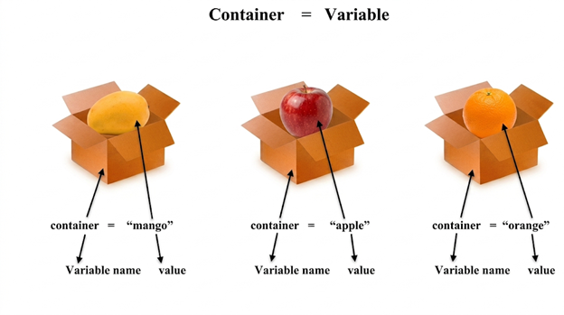
Data types
Strings: “Hi” Words/Sentences
Ints: 1, 2, 3 . . . . Integers; numbers without decimals
Floats: 1.2, 5.890 . . . . Any other number that isn’t an integer

Slide 7
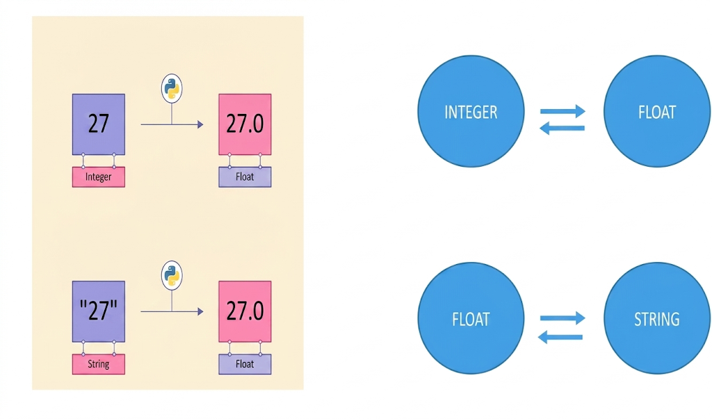
Type Casting
Conversion form one data type to an other
Notes:
(NOT COVERED IN LECTURE, PLEASE COVER FOR THE PROBLEMS SINCE WE USE IT)

Slide 8
Rounding numbers
The round() function is used to round a number to the nearest whole number or to a specific number of decimal places.
round(number, digits)
number → the value you want to round
digits → optional, tells Python how many decimal places to keep
print(round(3.14159, 2)) # Output: 3.14

Slide 9
If elif else
if, elif, and else are used when a program needs to make decisions based on different conditions.
if → “Is this condition true?”
elif → “If not, is this other condition true?”
else → “If none of the above are true, do this.”

Slide 10
Before We Start...
Are there any questions?

Slide 11
Section Problem #1: To Mars
Notes:
Teaching Mars Weight [10-20 minutes]

Slide 12
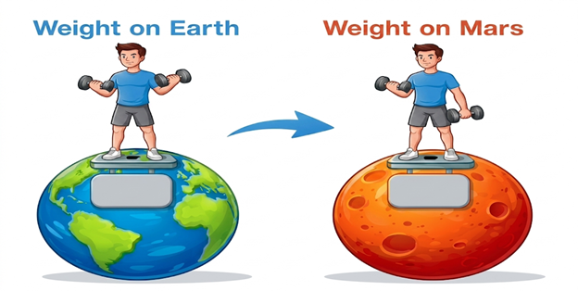
Earthling’s weight on Mars is 37.8% of their weight on Earth. Write a Python program that prompts an Earthling to enter their weight on Earth and prints their calculated weight on Mars. The output should be rounded to two decimal places when necessary. Python has a round function which can help you with this. You pass in the value to be rounded and the number of decimal places to use.
Notes:
A while back, NASA made history with the first controlled flight on another planet. Its latest Mars Rover, Perseverance, has onboard a 50cm high helicopter called Ingenuity. Ingenuity made its third flight, during which it flew faster and further than it had on any of its test flights on Earth. Interestingly, Ingenuity uses Python for some of its flight modeling software!

Slide 13
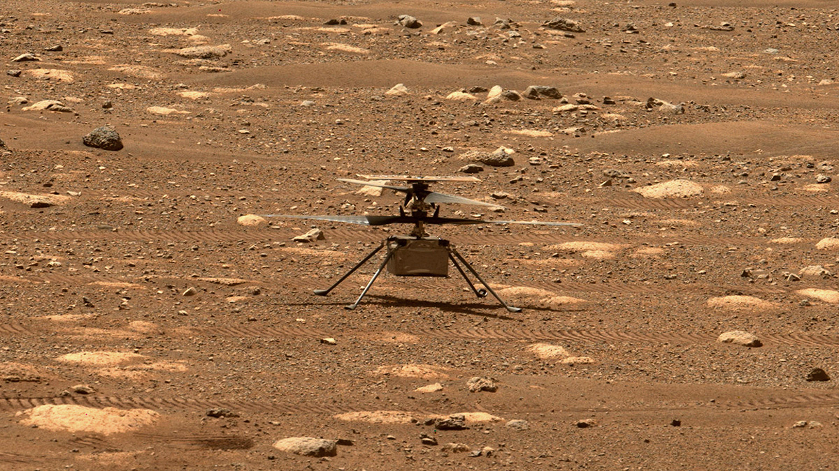
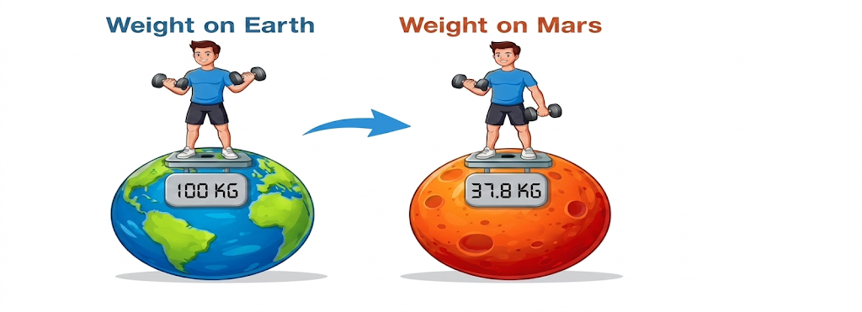
Section Problem #1: To Mars!!!
Mars constant = 37.8% = 0.378
Weight on Mars = (weight on earth) X (Mars constant)
100 X 0.378

Slide 14
Let’s Code!
For this activity, you’ll be working in breakout rooms with each other
100
37.8

Slide 15
Section Problem #2: Planetary Weights
Notes:
Teaching Planetary Weights [20 minutes]

Slide 16
Section Problem #2: Planetary Weights
Mars is not the only planet in our solar system with its own unique gravity. In fact, each planet has a different gravitational constant, which affects how much an object would weigh on that planet.

Slide 17
Section Problem #2: Planetary Weights
Write a Python program that prompts an Earthling to enter their weight on Earth and then to enter the name of a planet in our solar system. The program should print the equivalent weight on that planet. * You can assume that the user will always type in a planet with the first letter capitalized and you do not need to worry about the case where they type in something other than one of the above planets. *
CAMERON
MAGGIE

Slide 18
Section Problem #2: Planetary Weights
Here’s a list of constants for each planet’s gravity compared to Earth's:
Mercury: 37.6%
Venus: 88.9%
Mars: 37.8%
Jupiter: 236.0%
Saturn: 108.1%
Uranus: 81.5%
Neptune: 114.0%
CAMERON
MAGGIE

Slide 19
Section Problem #2: End Goals
120
Sample Input
Enter a weight on Earth: ↓ (Input 1) Enter a weight on Earth: 120 ↓ Enter a planet: ↓ (Input 2) Enter a planet: Mars
* User input is italicized and bolded for visual clarity *
Sample Output
The equivalent weight on Mars: 45.36
45.36
Notes:
Here’s one example run of our new program. Though it is almost functionally equivalent to the previous program, that it isn’t necessarily the case.

Slide 20
Let’s Code!
For this activity, we’ll break out again, and then come back together!

